Slide 1
REAL TIME SYSTEM
(Computer Bus)
By: Mohammad Aiman Naufal bin Abd Rahim

Slide 2
OVERVIEW
01
EXAMPLES
02
WELCOME!
IN BRIEF
TABLE OF CONTENTS
04
03
EVENTS
05
SNEAK PEEK
06
Here you could describe the topic of the section
Here you could describe the topic of the section
Here you could describe the topic of the section
Here you could describe the topic of the section
Here you could describe the topic of the section
Here you could describe the topic of the section

Slide 3
01
OVERVIEW

Slide 4
BUS
A bus is a connection between components or devices connected to a computer

Slide 5
TYPES OF COMPUTER BUS
PARALLEL VS SERIAL
INTERNAL VS EXTERNAL
A parallel bus transmits data several bits at a time. A serial bus, on the other hand, transfers data one bit at a time.
An internal bus allows internal components, such as a video card and memory, to communicate with one another. An external bus can communicate with external components like a USB or SCSI device.

Slide 6
02
EXAMPLES

Slide 7
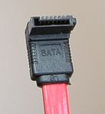
SATA I
Speed: 1.5 Gb/s
Distance: Up to 1 meter
Data Format:
Bandwidth: 150MB/s
Security/safety:
Advantage/disadvantage:

Slide 8
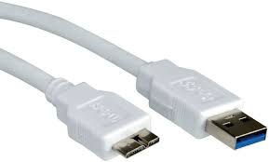
USB 3.2 Gen 1
Speed: 5 Gb/s
Distance: Up to 3 meter
Data Format:
Bandwidth: 5 Gb/s
Security/safety:
Advantage/disadvantage:

Slide 9
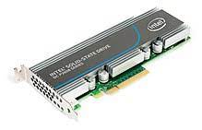
PCIe 1.0
Speed: 2.5 GT/s
Distance: Up to 15 inches
Data Format:
Bandwidth: 250 MB/s
Security/safety:
Advantage/disadvantage:

